Slide 1



UNIT 1
LESSON 3
ALL THAT GLITTERS
Part 4

Slide 2
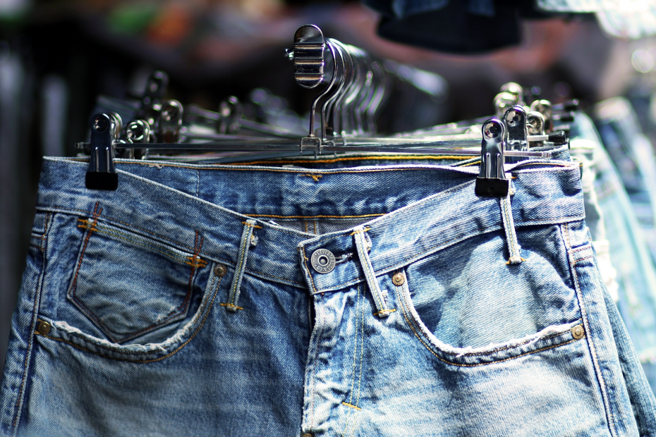
It’s a piece of clothing that is strong, but comfortable, and always in fashion.

Slide 3
1 The California Gold Rush started in ... 1848 /1748
2 People went to California to ... make gold/seek gold.
3 Levi Strauss was an immigrant from ... France/Germany.
4 He lived in New York with his ... France/Germany.
5 They were ... sailor/tailors.
6 They sent him to California to ... buy clothes/sell clothes.
7 Gold miners needed ... strong but comfortable trousers/strong but comfortable shirts.
8 Levi Strauss imported denim from Nimes in ... France/Germany.
9 He founded a company and made ... a fortune/damage.

Slide 4

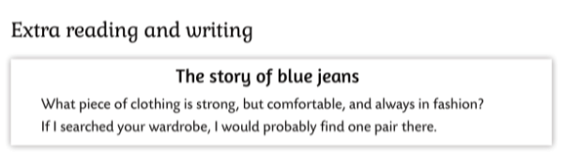
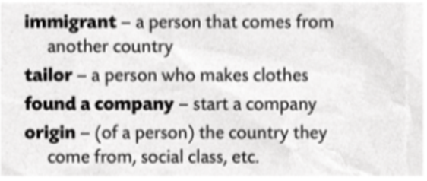

Slide 5
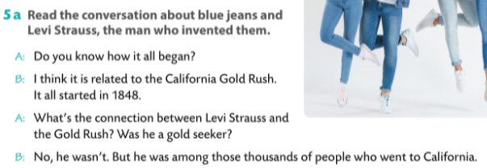
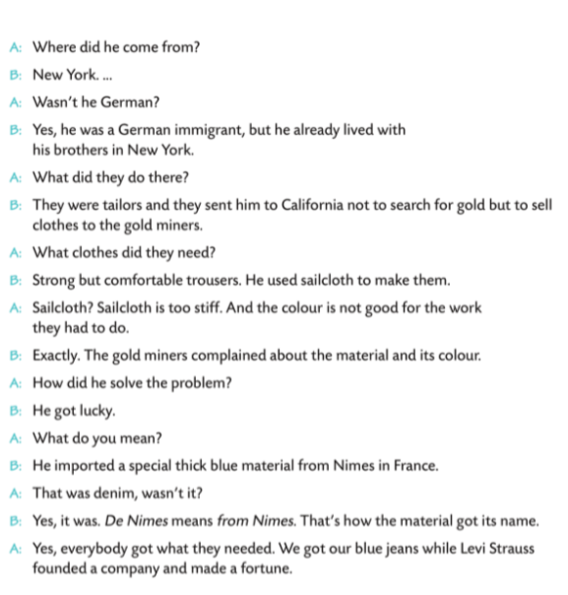
1 The California Gold Rush started in ... 1848 /1748
2 People went to California to ... make gold/seek gold.
3 Levi Strauss was an immigrant from ... France/Germany.
4 He lived in New York with his ... brothers/uncles.
5 They were ... sailor/tailors.
6 They sent him to California to ... buy clothes/sell clothes.
7 Gold miners needed ... strong but comfortable trousers/strong but comfortable shirts.
8 Levi Strauss imported denim from Nimes in ... France/Germany.
9 He founded a company and made ... a fortune/damage.

Slide 6
